Slide 1

LISTENING MODULE C
FUNCTIONS:
Listening to a piece of news about smog and its consequences.
Listening to a description of changes a company has gone through.
Listening and watching a video about a man’s decision of life.

Slide 2

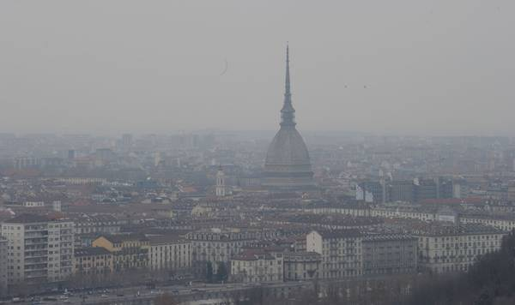
Listening 1
SMOG CAUSES DRIVING BAN IN ITALY
Pre-Listening Vocabulary
smog: smoke and other pollution combined with fog.
ban: a rule or law that disallows an action or prevents the use of something.
license plate: the numbers and letters that identify a vehicle’s owner.
exempt: not required to obey a rule or law that applies to others.

Slide 3
Comprehension Questions
Why are drivers in Milan and Rome facing driving restrictions this week?
What types of vehicles are exempt from the driving ban?
Why does the report mention Beijing?
Discussion Question: Should driving be banned in major city centers around the world? Why or why not?

Slide 4

Complete with the correct form of the verbs in brackets.
Smog Causes Driving Ban in Italy
Heavy smog …………… (result) in major driving restrictions in two of Italy’s largest cities. In Milan, a 6-hour driving ban ……………….. (put) in place on Monday with further restrictions to follow. In Rome, drivers must check their license plate numbers to see when they …………… (allow) to drive on Monday and Tuesday. Hybrid and other environmentally-friendly vehicles are exempt from the ban in Rome. An anti-smog public transit ticket with a reduced price ………………..(offer) in Milan. The smog ……………….. (worse) in these cities this week due to calm, dry weather. Similar driving restrictions ………………..(put) in place in Beijing this month due to severe pollution alerts.

Slide 5
Listening 2
Laura Santini works for a company which makes cans and containers for the food and drink industry. She explains to a journalist some of the changes which have taken place in this industry. Listen and take notes of the six changes she mentions.
CHANGES | DESCRIPTION
1. More efficient. Cans are made from two pieces of metals. Sides and bottom are made from one metal. | In the past cans were made from three pieces of metals (side, top and bottom) .
2.
3.
4.
5.
6.

Slide 6
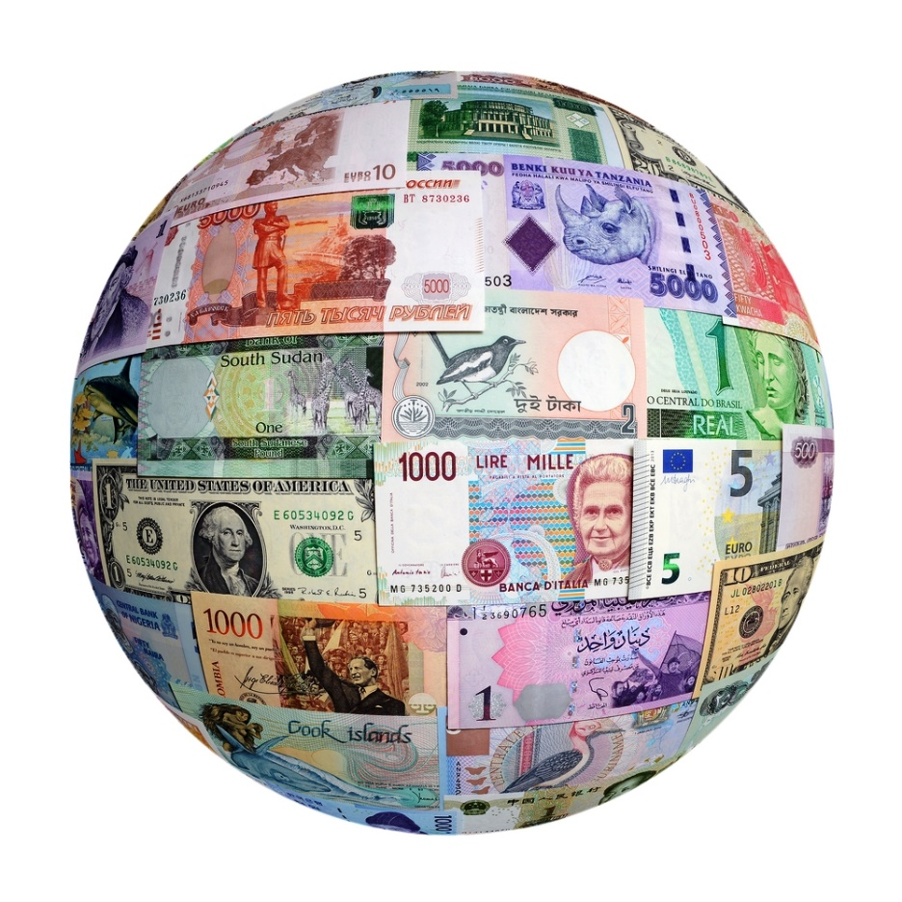
Listening 3
Can you imagine a world without money?

Slide 7
Pre-Listening Activities
Think the answers to the following questions and discuss with a partner: - How would you spend a day in your city or town without spending any money? - What activities can you do?
SUELO: THE MAN WHO QUIT MONEY

Slide 8

Watch the following video.

Slide 9
Comprehension questions:
1. When did Daniel give up money?
2. Finish the sentence; “Money is an _____________.”
3. How much money did he leave in the phone booth?
4. What did his friend think of his decision?
5. How did 2008 change the narrator’s perspective?
6. What did Daniel choose to live in?
7. Name his food sources.
8. Complete this phrase: “My philosophy is to use only what is freely ___________ or discarded and what is already ____________ and already ___________”.
9. What does he think will happen to money in the future?
10. Write Daniel’s complete idea, it starts like this: “We can cultivate freely giving and freely receiving, …………………
11. According to Daniel’s friend, why is the dessert a perfect place to live in?

Slide 10
After reading. Discussion.
Could you live a complete and happy life without money?
Where would you live?
What would you miss the most?
Imagine the scenario – how would a whole society survive without money?

